Slide 1
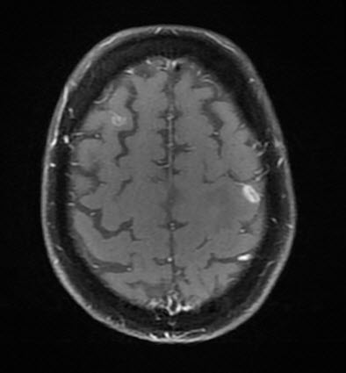
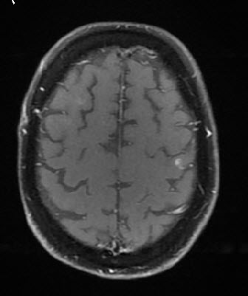
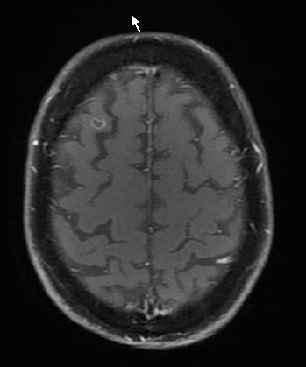
Tepotinib in patients with MET exon 14 skipping non-small cell lung cancer: Interim analysis of VISION Cohorts A and C
RESULTS
VISION comprises a large population of elderly patients with METex14 skipping NSCLC
Overall, most of the patients in Cohorts A and C that were assessed for efficacy (N=275) were elderly (median 72.4 years [range 41 to 94]), about half were male, half had smoking history, and most had adenocarcinoma
Intracranial activity (ad hoc retrospective analysis using RANO-BM criteria) of tepotinib was observed in patients with BM at baseline
Of 23 patients in Cohort A enrolled with BM at baseline, 15 were evaluable by RANO-BM
Five of seven patients had an intracranial response, and 13 of 15 achieved intracranial disease control
Kumar Prabhash¹, Harshal Chaudhari², Rolf Bruns³, Gordon Otto³, Andreas Johne³, Paul Paik^{4,5}
Copies of this e-Poster obtained through QR, AR and/or text key codes are for personal use only and may not be reproduced without written permission of the authors
Table 2. Baseline characteristics
¹Tata Memorial Hospital, Mumbai, India; ²Merck Specialties Pvt. Ltd, Mumbai, India, an affiliate of Merck KGaA; ³Merck Healthcare KGaA, Darmstadt, Germany; ⁴Memorial Sloan-Kettering Cancer Center, New York, NY, USA; ⁵Weill Cornell Medical College, New York, NY, USA
Baseline characteristics |  | Overall (N=275) | Treatment naïve (n=137) | Previously treated (n=138)
Median age, years (range) |  | 72.4 (41–94) | 74.6 (47–94) | 70.9 (41–89)
Sex, % | Male | 49.1 | 49.6 | 48.6
ECOG PS, % | 0/1 | 27.6/72.0 | 29.9/69.3 | 25.4/74.6
Smoking history,* % | Yes | 46.5 | 53.3 | 39.8
Histology, adenocarcinoma, % |  | 80.0 | 79.6 | 80.4
Brain metastasis,† % |  | 18.5 | 17.5 | 19.6
Figure 3. Intracranial response to tepotinib assessed by IRC per RANO-BM criteria
BOR
SD
PD
Measurable/target
brain lesions
Non-measurable/non-target
brain lesions only
CR
PR
CONCLUSIONS
METex14 skipping is an oncogenic driver that occurs in patients with NSCLC of advanced age
Tepotinib demonstrated robust systemic activity in patients with METex14 skipping NSCLC, and showed intracranial activity in patients with BM
Tepotinib was generally well tolerated, with a low proportion of TRAEs leading to discontinuation
*Smoking history was missing in ten patients; †Baseline brain metastases identified by IRC or investigator.
Best change in
sum of diameter for target lesions (%)
Tepotinib demonstrated an overall robust clinical activity irrespective of therapy line
Overall, ORR was 49.1%, mDOR was 13.8 months and mPFS was 10.8 months
In treatment-naïve patients, ORR was 54.0%, mDOR was 32.7 months and mPFS was 10.4 months
In previously treated patients, ORR was 44.2%, mDOR was 11.1 months and mPFS was 11.0 months
5/7 had overall intracranial BOR of PR
3 had CR in non-target lesions
3 had CR in target lesions
7/8 achieved intracranial disease control
Non-target lesions*
Non-CR/ Non-PD | Non-CR/ Non-PD | CR | - | - | Non-CR/ Non-PD | -
CR | CR | CR | Non-CR/ Non-PD | Non-CR/ Non-PD | Non-CR/ Non-PD | Non-CR/ Non-PD | PD
INTRODUCTION
Table 3. Efficacy of tepotinib
Intracranial PFS per RANO-BM (months)
METex14 skipping is reported in 3–4% of patients with NSCLC, and is sensitive to MET inhibition^{1–4}
Tepotinib is an oral, once daily, highly selective, potent MET TKI, with established clinical activity in MET-driven tumors⁵
In VISION Cohort A (median age 73.1 years [range 41 to 94]), tepotinib had robust and durable clinical activity in patients with METex14 skipping NSCLC (data cut off: July 2020)⁶
Here, we report the first interim analyses with confirmatory Cohort C data
Table 1. Tepotinib efficacy in VISION Cohort A (n=152)
Efficacy (IRC) | Overall (N=275) | Treatment naïve (n=137) | Previously treated (n=138)
ORR, % (95% CI) | 49.1 (43.0, 55.2) | 54.0 (45.3, 62.6) | 44.2 (35.8, 52.9)
BOR, n (%) CR PR SD PD NE | 0 135 (49.1) 71 (25.8) 34 (12.4) 35 (12.7) | 0 74 (54.0) 28 (20.4) 16 (11.7) 19 (13.9) | 0 61 (44.2) 43 (31.2) 18 (13.0) 16 (11.6)
mDOR, mos (95% CI) | 13.8 (9.9, 19.4) | 32.7 (9.0, ne) | 11.1 (8.4, 18.5)
mPFS, mos (95% CI) | 10.8 (8.5, 12.4) | 10.4 (8.4, 15.3) | 11.0 (8.2, 12.7)
Prior radiotherapy received† (dose [Gy]/fractions)
Time between radiotherapy and tepotinib (weeks)
Systemic BOR by IRC per RECIST v1.1 (months on treatment)
20/1 | 30/10 | 20/1, 22/1, 22/1 | 27/3 | 19/1 | 40/2 | 27/3
5.3 | 26.1 | 5.4 | 4.0 | 7.1 | 14.3 | 2.6
17.7 | 9.8 | 8.3 | 2.2 | 9.8 | 6.4 | 8.0
30/3, 20/1‡ | 22/1§ |  | 30/10 | 20/1, 20/1, 20/1 | 27/3
5.6 | 16.4 |  | 34.4 | 44 | 3.1
19.3 | 10.7 | 11.3 | 5.8 | 4.8 | 6.8 | 1.3 | 1.4
ORR | 44.7%
mDOR | 11.1 months
mPFS | 8.9 months
*Dashes (-) indicate non-target lesions were not recorded; †Radiotherapy for brain lesions; ‡20 Gy in one fraction was reported during the same time period as 30 Gy in three fractions; §Gamma Knife was also received 31.4 weeks before start of tepotinib treatment.
METHODS
Figure 4. MRI* images showing intracranial response to tepotinib in target lesion per RANO-BM criteria
VISION (NCT02864992) is a single-arm, Phase II trial of tepotinib in patients with NSCLC harboring METex14 skipping (Cohorts A and C)
Baseline
One target lesion
(11.1 mm)
Week 6
Target lesion PR
5.8 mm (–47.8%)
Week 36
Target lesion CR
0 mm (–100%)
Figure 1. Study design, endpoints and eligibility criteria of VISION
Figure 2. Overall DOR and PFS
Endpoints† (data cut off: Feb 2021)
1.0
DOR
Events, n | mDOR, months (95% CI)
50 | 13.8 (9.9, 19.4)
Patients with advanced or metastatic METex14 skipping NSCLC
(by LBx and/or TBx)
Cohort A
(primary analysis)
Tepotinib
500 mg
(450 mg active moiety)
Oral QD*
0.8
Primary endpoint
Objective response by IRC according to RECIST v1.1 criteria
0.6
Kaplan–Meier estimate
0.4
Cohort C
(confirmatory analysis)
Key secondary endpoints
DOR, PFS, OS
Safety (AEs were assessed using NCI-CTCAE v4.03)
0.2
0.0
0
3
6
9
12
15
18
21
24
27
30
33
36
39
42
45
48
51
*T1-weighted, gadolinium-enhanced.
*Treatment continues until disease progression, intolerable toxicity, or withdrawal of consent.
†Efficacy was assessed in patients with more than 3 months’ follow-up, and safety was analyzed in all patients having received at least one dose of tepotinib by the data cut-off.
Patients at risk:
DOR (months)
Tepotinib was generally well tolerated, with a low proportion of TRAEs leading to discontinuation
Grade ≥3 TRAEs occurred in 29.6% of patients, leading to permanent discontinuation in 14.1% of patients
135
120
79
49
27
21
12
9
7
7
6
3
1
1
1
1
0
0
Key inclusion criteria
≥18 years of age
Histologically or cytologically confirmed NSCLC with METex14 skipping detected by LBx and/or TBx
Measurable disease
ECOG performance status 0/1
Prior immunotherapy allowed
Patients with brain metastases
– Asymptomatic
– Symptomatic/stable
X
Key exclusion criteria
Tumors harboring EGFR mutations or ALK rearrangements
>2 lines of prior therapy
Prior use of MET inhibitors
Symptomatic brain metastases
1.0
PFS
Events, n | mPFS, months (95% CI)
131 | 10.8 (8.5, 12.4)
0.8
Table 4. TRAEs
0.6
TRAE, n (%) | Overall (N=291)
Any grade | 264 (90.7)
Grade ≥3 | 86 (29.6)
Leading to dose reduction | 90 (30.9)
Leading to temporary interruption | 114 (39.2)
Leading to permanent discontinuation | 41 (14.1)
Kaplan–Meier estimate
Neurologically unstable
Required an increase in steroid dose within 2 weeks
Received prior stereotactic radiosurgery/gamma knife within 2 weeks
Received other prior treatment for brain metastases within 4 weeks
Leptomeningeal disease
0.4
0.2
0.0
0
3
6
9
12
15
18
21
24
27
30
33
36
39
42
45
48
51
Patients at risk:
PFS (months)
275
204
139
81
50
33
19
11
10
9
7
6
1
1
1
1
1
0
Abbreviations: AE, adverse event; ALK, anaplastic lymphoma kinase; BM, brain metastasis; BOR, best objective response; CI, confidence interval; CR, complete response; DOR, duration of response; ECOG PS, Eastern Cooperative Oncology Group; EGFR, epidermal growth factor receptor; IRC, independent review committee; LBx, liquid biopsy; mDOR, median duration of response; MET, mesenchymal–epithelial transition factor; METex14, MET exon 14; mPFS, median progression-free survival; MRI, magnetic resonance imaging; NCI-CTCAE, National Cancer Institute Common Terminology Criteria for Adverse Events; ne, not estimable; NE, not evaluable; NSCLC, non-small cell lung cancer; ORR, objective response rate; OS, overall survival; PD, progressive disease; PFS, progression-free survival; PR, partial response; QD, once daily; RANO-BM, Response Assessment in Neuro-Oncology Brain Metastases; RECIST, Response Evaluation Criteria in Solid Tumors; SD, stable disease; TBx, tissue biopsy; TKI, tyrosine kinase inhibitor; TRAE, treatment-related adverse event.
References: 1. Reungwetwattana T, et al. Lung Cancer. 2017;103:27–37; 2. Rosell R, Karachaliou N. Lancet. 2016;387:1354–1356; 3. Salgia R, et al. Can Treat Rev. 2020;87:102022; 4. Paik PK, et al. Cancer Discov. 2015;5:842–849; 5. Falchook GS, et al. Clin Cancer Res. 2020;26(6):1237–1246; 6. Paik PK, et al. J Thorac Oncol. 2021;16(3):S174 [and presentation].
Acknowledgments: The authors would like to thank patients, all investigators and co-investigators, and the study teams at all participating centers and at Merck Healthcare KGaA, Darmstadt, Germany. The trial was sponsored by Merck Healthcare KGaA, Darmstadt, Germany. Medical writing and editorial assistance was provided by Pritha Bhunia of Syneos Health, UK, and funded by Merck Healthcare KGaA, Darmstadt, Germany.
Disclosures: K.P. has nothing to disclose; H.C. is an employee of Merck Specialties Pvt. Ltd, Mumbai, India, an affiliate of Merck KGaA; R.B., G.O. and A.J. are employees of Merck Healthcare KGaA.
Presented at the Lung Cancer Updates Meeting | October 1–2, 2021

